Slide 1
DS100 Lecture 6: Visualization
Slides by:
Deborah Nolan deborah_nolan@berkeley.edu
Sp18 updates: Fernando Perez fernando.perez@berkeley.edu

Slide 2
Why is Graphics a topic in this course?
Visualization belongs in every stage of the data life cycle
Plots can uncover structure in data that can’t be detected from numerical summaries
Visualization is an important communication skill

Slide 3
Goals of this lecture
Guidelines and general philosophy
Reveal the data
Facilitate Comparisons
Add information
Iterate
Techniques for following guidelines
Scale
Conditioning/faceting
Perception: color
Transformations
Adding context
Smoothing & other large data considerations

Slide 4
Good Starting Place – Know your data type
Quantitative (Numeric)
Continuous (e.g., health care expenditure, temperature)
Discrete (e.g., number of siblings)
Qualitative (Categorical)
Nominal (e.g., lane of traffic, country)
Ordinal (e.g., Yelp rating, education level)
See table that maps data types to plot types at end of slides

Slide 5
Review of Plot Types

Slide 6
Kaiser Study
Data provenance:
Mothers who use Kaiser
Starts as administrative dataset, expanded into study with new data
Selection mechanism not random
Oakland Kaiser mothers
1960s
Measure the babies weight (in ounces) at birth
All babies:
Male
Single births (no twins, etc.)
Survived 28 days
Notes:
Data available from Prof. Nolan’s statlab project that provides many examples and case studies in statistics.
Q: is it a simple random sample?

Slide 7
Information collected on mother’s and their babies
Birth weight (ounces)
Gestation (weeks)
Parity - total number of previous pregnancies
Mother’s height and weight
Mother’s smoking status
Mother’s age, race, education level, income
Father’s information and more…
Notes:
What kinds of data are these? Qualitative or quantitative.
Income: actually qualitative, b/c it’s reported in brackets, not absolute amounts.

Slide 8
Quantitative Variable Birthweight
Histogram
Density Curve
How would we describe the distribution of birth weight?
Notes:
Properties of these data?
Modes? Basically unimodal.
Skew? Very little
Tails? Both short.

Slide 9
Qualitative Variable Education level
Bar Width – has no meaning
Why do we not reorder the bars according from shortest to tallest?
Notes:
Bar chart – width of bar has no meaning
Bar chart – often prefer proportions or percentages over counts

Slide 10
Dotchart/Stripchart Education Level
Width of bars in a bar plot have no meaning
Dot plot (aka Cleveland) focus on comparison of the values
Notes:
Dot

Slide 11
Discrete Quantitative # of Siblings
Bar plot – height not area is the proportion
What’s the difference between these 2 plots?

Slide 12
Plotting Pairs of Quantitative Variables
Scatter plot uncovers form of relationship between 2 variables
Linear relationships are particularly simple to interpret
Simple and elegant statistical theory for linear relationships
Models are typically approximations, choose a simpler model over a complex one

Slide 13
Pairs of Quantitative Variables

Slide 14
Pairs of Qualitative Variables
Smoking status normalized within Education level
Side-by-side Bar Plot
What’s the difference between these 2 plots?
Notes:
Count vs proportion – neither is “right”, but they convey different information.

Slide 15
Interaction/Factor Plot
Smoking status normalized within Education level

Slide 16
Mix Quantitative & Qualitative
Side-by-side Boxplots
Side-by-side violin plots

Slide 17
Mix of Qualitative and Quantitative
Overlaid bars/curves

Slide 18
Examples of Plots that Need Improvement

Slide 19
2015 Congressional Hearing: Planned Parenthood
Congressman Chaffetz (R-UT), chair US House Oversight Committee
Investigation of federal funding of Planned Parenthood
Chaffetz showed a plot which originally appeared in a report by Americans United for Life (http://www.aul.org).
Report available at:
https://oversight.house.gov/interactivepage/plannedparenthood

Slide 20
Planned Parenthood Procedures
Procedures:
Cancer screenings
Abortion
Time: 2006 to 2013
How many data points are in this plot?
What’s suspicious about this plot?
Note: This is an administrative dataset

Slide 21
Earnings
Bureau of Labor Statistics
Oversees scientific surveys related to economic health of the country
Current Population Survey
Collects data on the earnings
www.bls.gov - Web interface to a report generating app

Slide 22
Earnings
Which comparisons can be easily made with this plot?
What comparisons are most interesting or important?
Note: This is a probability sample (AKA scientific sample)

Slide 23
Cherry Blossom Run
10 mile run in Washington DC each April
Race organizers make results available on Web
Runner name, age, gender, address, hometown, time
Race results from 1999 to 2016
In 2012 nearly 17,000 runners ranging in age from 9 to 89 participated
http://www.cherryblossom.org/

Slide 24
Cherry Blossom Run
Scatter plot of run time (minutes) by age (years)
70,000 points in this plot.
What’s the relationship between run time and age?
Note: This is a self-selected sample

Slide 26
Techniques
Scale | Conditioning | Perception | Transformation | Context | Smoothing & Reducing | Philosophy

Slide 27
Planned Parenthood Procedures

Slide 28
Scale
Scale | Conditioning | Perception | Transformation | Context | Smoothing | Philosophy

Slide 29
Planned Parenthood Procedures
All points and lines are on the same scale
How does this plot change the perception of the information?
There has been a dramatic decrease in cancer screenings which dominates this plot
The scales of the two procedures are very different – consider representing as percentages instead
Scale | Conditioning | Perception | Transformation | Context | Smoothing | Philosophy

Slide 30
Planned Parenthood Procedures
Procedures in 2006 and 2013 as a percentage
Abortions increased from 13% to 26% of total procedures
May want to plot the percent change, screenings fell 50%
Scale | Conditioning | Perception | Transformation | Context | Smoothing | Philosophy

Slide 31
Choosing the Scale
Choose axis limit to fill the plotting region
In necessary,
Zoom in to focus on region with bulk of data
Make multiple plots of different regions
Transform data to improve resolution (TBC)
Don’t change scale mid-axis
Don’t use two different scales for the same axis
Scale | Conditioning | Perception | Transformation | Context | Smoothing | Philosophy

Slide 32
Earnings

Slide 33
Conditioning
Scale | Conditioning | Perception | Transformation | Context | Smoothing | Philosophy
Notes:
Also known as faceting

Slide 34
Earnings
Emphasize the important difference –
Lines make it easier to see growth in gap
Placement of one point above the other makes it easier to compare males & females
Scale | Conditioning | Perception | Transformation | Context | Smoothing | Philosophy

Slide 35
Conditioning – Distributions & Relationships in subgroups
Superpose (over plot) density curves, fitted curves and lines from different subgroups
Juxtapose (plot next to) scatter plots, histograms & keep x and y scales the same across plots to facilitate comparison
Use color and plotting symbols to represent additional variables
Scale | Conditioning | Perception | Transformation | Context | Smoothing | Philosophy

Slide 36
Perception - Color
Scale | Conditioning | Perception | Transformation | Context | Smoothing | Philosophy

Slide 37
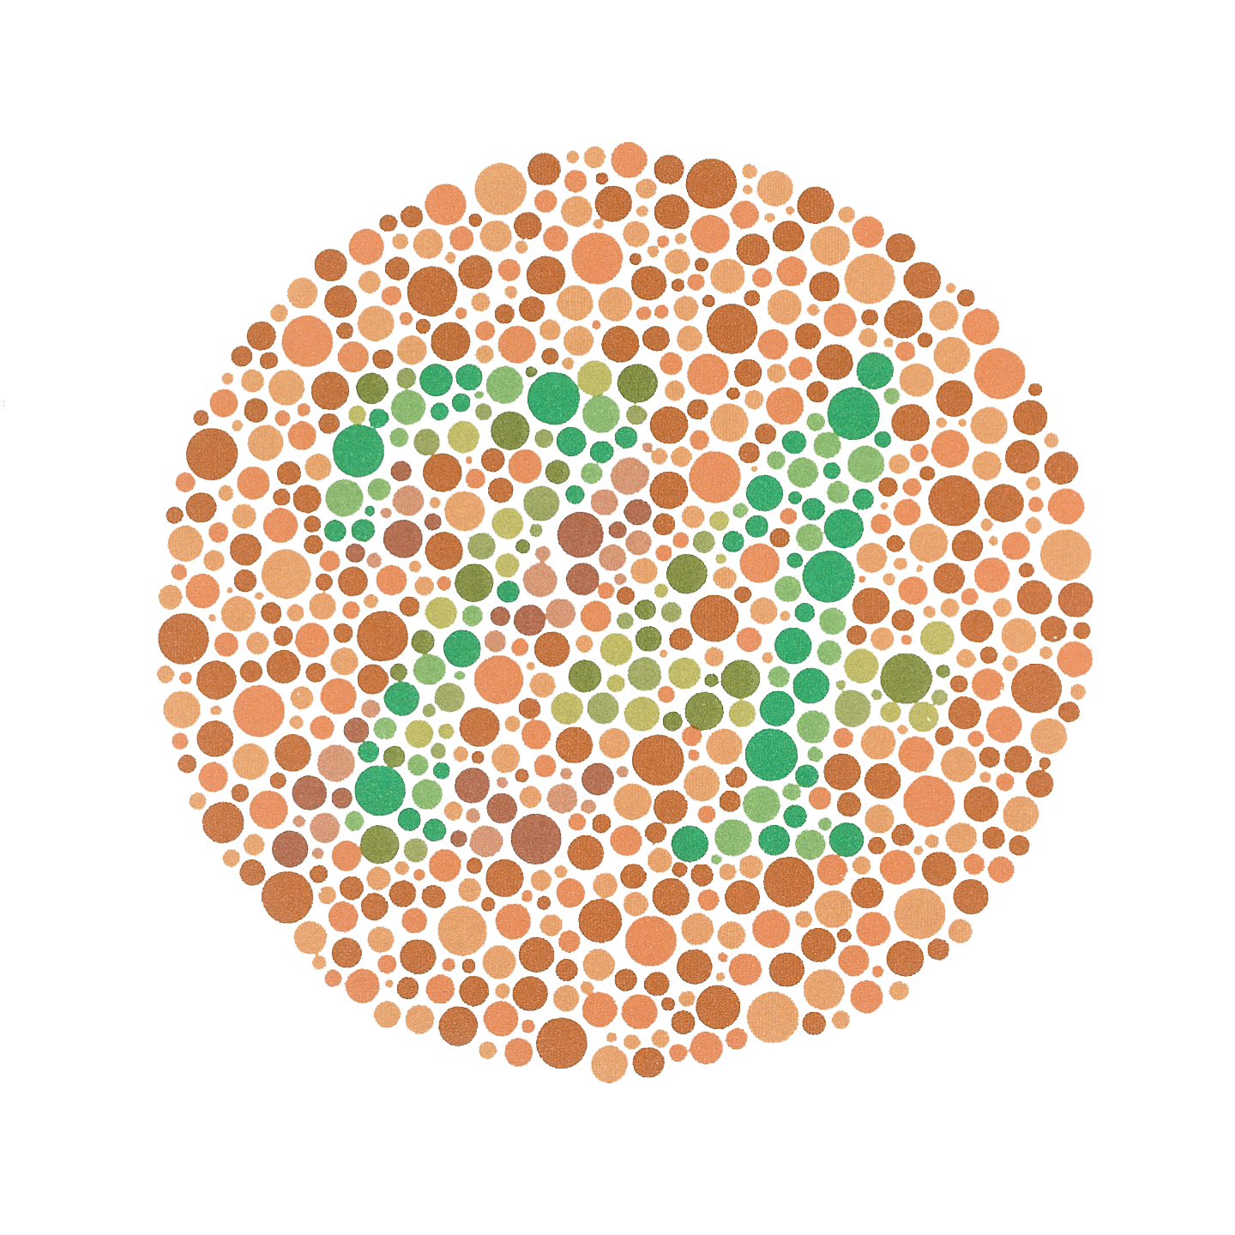
Color Guidelines
Choosing a set of colors which work well together is a challenging task for anyone who does not have an intuitive gift for color
7-10% of males are red-green color blind.
Scale | Conditioning | Perception | Transformation | Context | Smoothing | Philosophy

Slide 38
Colorfulness
Saturated/colorful colors are hard to look at for a long time.
They tend to produce an after-image eﬀect which can be distracting.
Scale | Conditioning | Perception | Transformation | Context | Smoothing | Philosophy

Slide 39
Luminance
Areas should be rendered with colors of similar luminance (brightness).
Lighter colors tend to make areas look larger than darker colors
Scale | Conditioning | Perception | Transformation | Context | Smoothing | Philosophy

Slide 40
Matplotlib’s virdis: https://bids.github.io/colormap

Slide 41
Data Type and Color
Qualitative – Choose a qualitative scheme that makes it easy to distinguish between categories
Quantitative – Choose a color scheme that implies magnitude.
Does the data progress from low to high? Use a sequential scheme where light colors are for low values
Do both low and high value deserve equal emphasis? Use a diverging scheme where light colors represent middle values
Scale | Conditioning | Perception | Transformation | Context | Smoothing | Philosophy

Slide 42
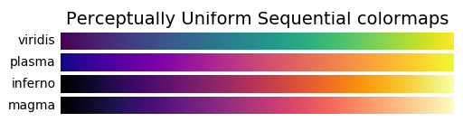
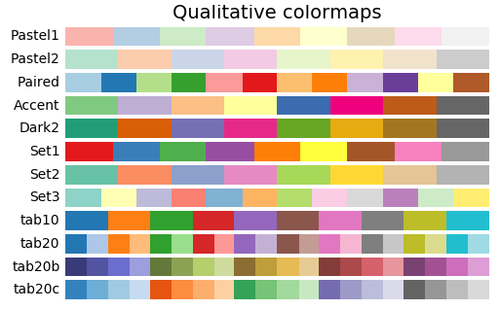
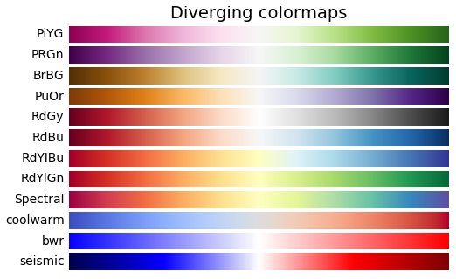
Colormaps
https://matplotlib.org/examples/color/colormaps_reference.html
Scale | Conditioning | Perception | Transformation | Context | Smoothing | Philosophy

Slide 43
Perception - Length
Scale | Conditioning | Perception | Transformation | Context | Smoothing | Philosophy

Slide 44
Bar plot, Pie chart, Dot chart
Experiments found that angle judgments based on pie charts are less accurate than length judgments from bar charts
Length is easier to compare than area or volume
Lengths that fall on a line are easier to compare than lengths on parallel lines, i.e., judgments based on dot charts are easier to make than judgments based on bar plots
Scale | Conditioning | Perception | Transformation | Context | Smoothing | Philosophy

Slide 45
Scale | Conditioning | Perception | Transformation | Context | Smoothing | Philosophy

Slide 46
Which of these plots is easiest to read?
B
C
A
http://bit.ly/ds100-fa18-???

Slide 47
Stacking and Jiggling
Stacked bar plots and histograms are difficult to read because the base line moves from one bar to the next
Line plots where the area between successive lines represent the measurement are very difficult to read because the base line jiggles up and down.
Scale | Conditioning | Perception | Transformation | Context | Smoothing | Philosophy

Slide 48
CO2 Emissions from Fuel Consumption
Data on historical carbon dioxide (CO2) emissions from fuel combustion (http://cait.wri.org)
Country annual CO2 emissions date back to 1850
Typical report on trends since 1950 for the 14 countries that emitted the greatest amount of CO2 in 2012
World Resources Institute (http://www.wri.org/)
Scale | Conditioning | Perception | Transformation | Context | Smoothing | Philosophy

Slide 49
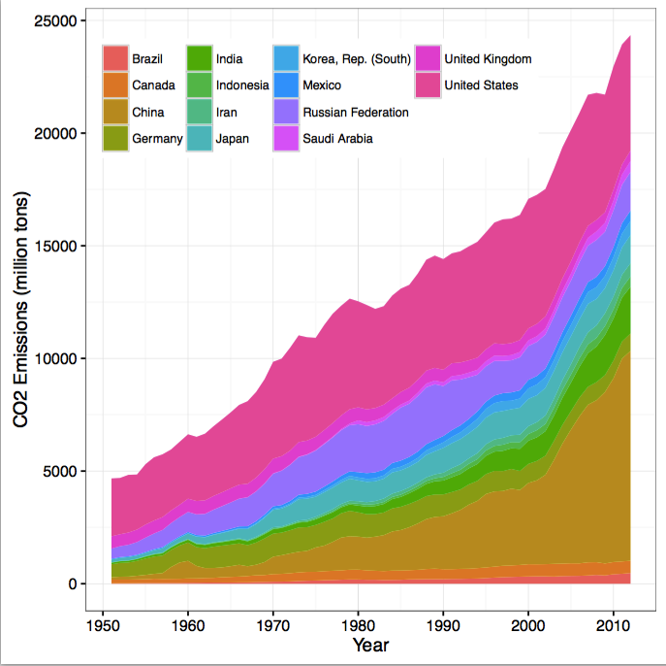
CO2 Emissions
Scale | Conditioning | Perception | Transformation | Context | Smoothing | Philosophy

Slide 50
Transformations
Scale | Conditioning | Perception | Transformation | Context | Smoothing | Philosophy

Slide 51
Why Transform Variables?
Reveal distribution of most of the observations (otherwise much of the data is squashed in a small region)
Reveal anomalies on the “other side” of the data
Numerical summaries of transformed data are better summaries of a symmetric distribution
Logarithmic transformations take care of most needs.
Scale | Conditioning | Perception | Transformation | Context | Smoothing | Philosophy

Slide 52
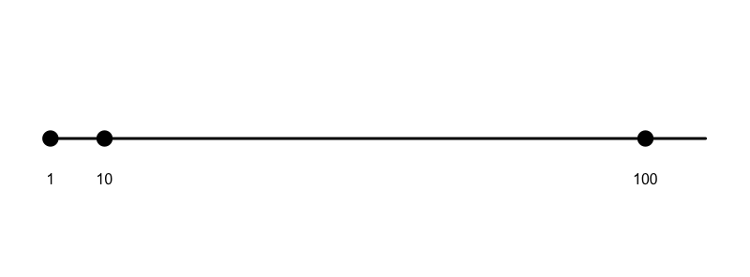
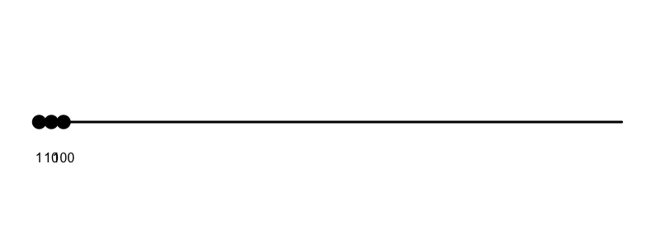
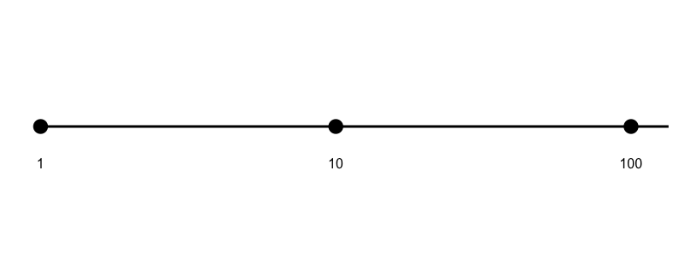
Log transformation
TRANSFORM
ZOOM IN

Slide 53
Basic Functional Relations

Slide 54
Log transformation: Swiss army knife

Slide 55
Log transformation
TRANSFORM
ZOOM IN

Slide 56
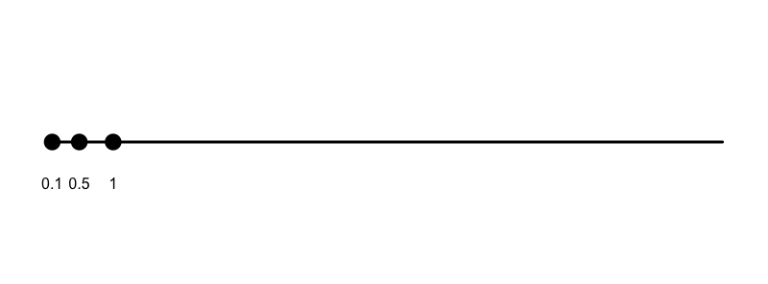
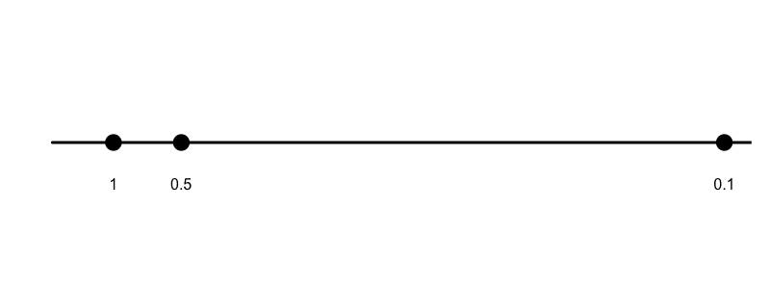
Inverse transformation
TRANSFORM

Slide 57
Power Transformation
Box-Cox Transformation
Effective when max/min > 5
Sometimes add a shift before transform
Ratio of hinges can help select a transformation
Courtesy of J. Fox
Scale | Conditioning | Perception | Transformation | Context | Smoothing | Philosophy
Notes:
Transform the data and compute the ratio of the hinges

Slide 58
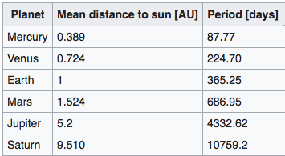
Logs and complex relations Kepler’s third law (1619)
Scale | Conditioning | Perception | Transformation | Context | Smoothing | Philosophy
Notes:
Transform the data and compute the ratio of the hinges

Slide 59
Logs and complex relations Kepler’s third law
Scale | Conditioning | Perception | Transformation | Context | Smoothing | Philosophy
Notes:
Transform the data and compute the ratio of the hinges

Slide 60
Logs and complex relations
Scale | Conditioning | Perception | Transformation | Context | Smoothing | Philosophy
Notes:
Transform the data and compute the ratio of the hinges

Slide 61
Why Straighten Relationships?
Easier to uncover the form of the relationship if we can transform it to linear relationship; we see what transformation used to make it linear
Linear relationships are particularly simple to interpret & fit
Choose a transformation that’s simple and easily interpreted in the context of the problem, e.g., a power of 2, 3, ½, 0 (log), -1
Scale | Conditioning | Perception | Transformation | Context | Smoothing | Philosophy

Slide 62
Straighten Relationships with Transformations
Scale | Conditioning | Perception | Transformation | Context | Smoothing | Philosophy

Slide 63
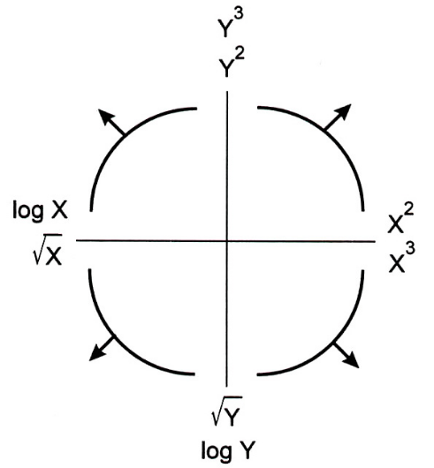
Straighten Relationships with Transformations
Tukey-Mosteller
Bulge Diagram
Scale | Conditioning | Perception | Transformation | Context | Smoothing | Philosophy

Slide 64
Power transformations
Bulge diagram says:
go up power ladder in x or
down the power ladder in y or
both
This is what we are looking for:
monotone and
linear
Some times a square root transformation can help
Shift positive and then transform can work

Slide 65
World Bank Country Statistics
World Bank provides financial and technical assistance to developing countries.
In 2010, the World Bank launched an Open Data Website that provides access to data from their reports on topics such as GDP, education, health, and the environment.
We are interested in the relationship between life expectancy and health expenditures
These variables are measured at the country level
Scale | Conditioning | Perception | Transformation | Context | Smoothing | Philosophy

Slide 66
Healthcare Costs & Life Expectancy
What does the bulge diagram tell us?
Scale | Conditioning | Perception | Transformation | Context | Smoothing | Philosophy

Slide 67
Healthcare Costs
Scale | Conditioning | Perception | Transformation | Context | Smoothing | Philosophy

Slide 68
Life Expectancy
Unusual feature – left skew. Upper bound on life expectancy
What transformation?
Range is factor of 2 so shift first
Pull up the low end with a square or cube transformation
Scale | Conditioning | Perception | Transformation | Context | Smoothing | Philosophy

Slide 69
Healthcare Costs & Life Expectancy
Issues remaining:
3 unusual countries
Complexity of cube model
Scale | Conditioning | Perception | Transformation | Context | Smoothing | Philosophy

Slide 70
Add Context
Scale | Conditioning | Perception | Transformation | Context | Smoothing | Philosophy

Slide 71
Add Context
Label axes, include units
Add Reference lines and markers for important values
Label points of unusual/interesting observations
Include captions that describe data, how plotted, and describe important features
Scale | Conditioning | Perception | Transformation | Context | Smoothing | Philosophy

Slide 72
Large n (records) Smoothing
Scale | Conditioning | Perception | Transformation | Context | Smoothing | Philosophy

Slide 73
Cherry Blossom Run
3-dimensional histogram is needed, but hard to come by
Use heat map or hexbin plot or transparency or contour plot
Make a smooth curve that takes local averages to see the conditional center, i.e., average y in a neighborhood of x
Scale | Conditioning | Perception | Transformation | Context | Smoothing | Philosophy

Slide 74
Smoothing Detour

Slide 75
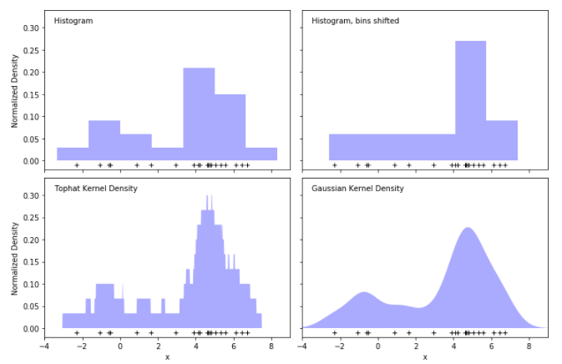
http://scikit-learn.org/stable/modules/density.html

Slide 76
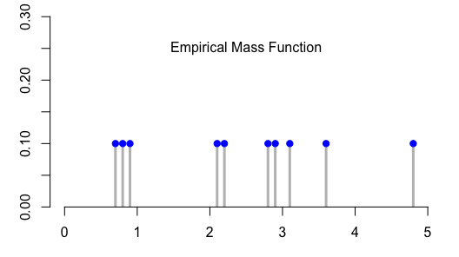
A Small Dataset
10 values
0.7, 0.8, 0.9, 2.1, 2.2, 2.8, 2.9, 3.1, 3.6, 4.8
Each value is 1/10 of the sample

Slide 77
We smooth these 1/10 point masses
BECAUSE
this is a sample and we believe that other values near the ones we observed are reasonable
we want to focus on general structure rather than individual observations

Slide 78
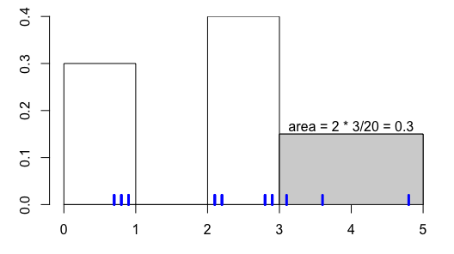
A histogram smooths
We want to smooth out these 1/10 point masses because
this is a sample and we believe that other values near the ones we observed are reasonable
we want to focus on general structure rather than individual observations
The values 3.1, 3.6, and 4.8 have their empirical mass (3/10) spread over the bin [3,5]

Slide 79
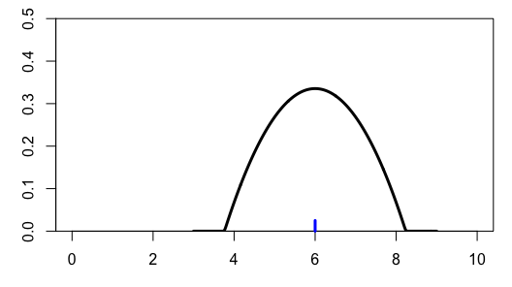
Kernel Density Estimate: Alternative Smoother
Consider one point
Smooth it’s empirical mass with a kernel function,
rather than a histogram bin
Area under this curve is 1

Slide 80
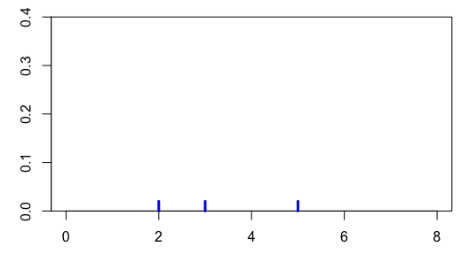
KDE – 3 points

Slide 81
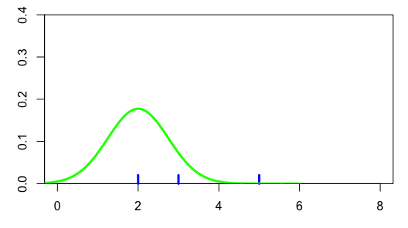
KDE – 3 points
Place a kernel
on each observation

Slide 82
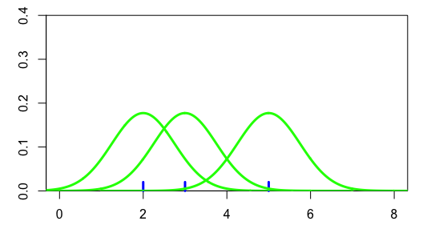
KDE – 3 points
The area under each of the
kernels is 1/3

Slide 83
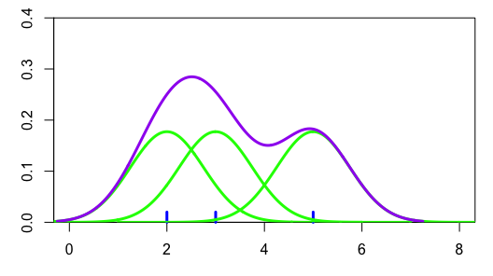
KDE – 3 points
Sum the 3 kernels at each point to get the density curve
K_{h} is the Kernel function
h refers to how peaked /spread the kernel is

Slide 84
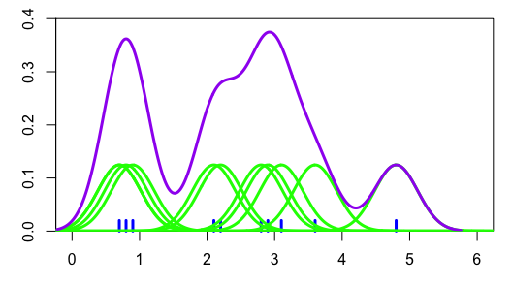
Back to our set of 10 values
0.7, 0.8, 0.9, 2.1, 2.2, 2.8, 2.9, 3.1, 3.6, 4.8

Slide 85
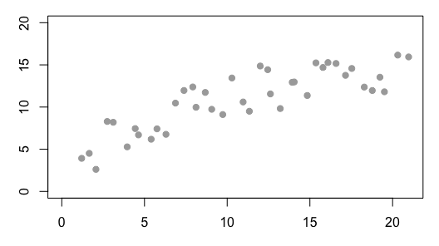
Smoothing Scatter plots
Now we want to smooth the y-values as a function of x

Slide 86
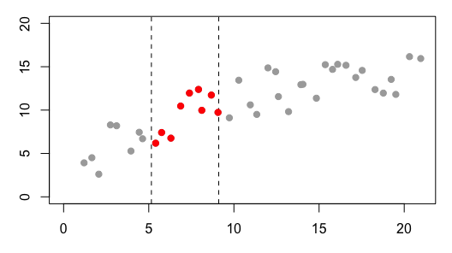
Smoothing Scatter plots
For an x-value
consider all of the x’s near it
Take an average of the y-values

Slide 87
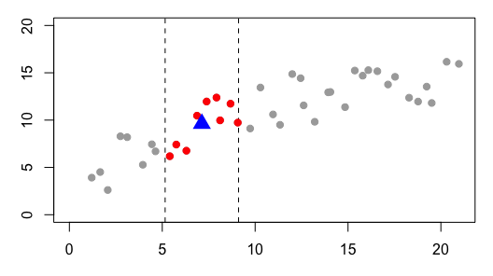
Smoothing Scatter plots
For an x-value
consider all of the x’s near it
Take an average of the y-values

Slide 88
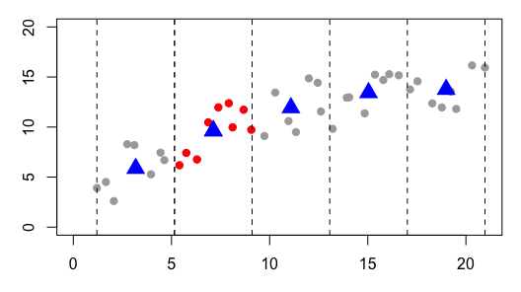
Smoothing Scatter plots
Create bins for all x
Average y-values in each bin

Slide 89
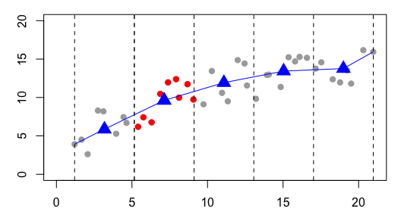
Smoothing Scatter plots
These averages sketch out a curve

Slide 90
Smoothing Scatter plots
Rather than a simple average in fixed bins
We use kernels positioned on the x_{i} to determine the weights to place on the y_{i} in the average
The denominator ensures the weights sum to 1

Slide 91
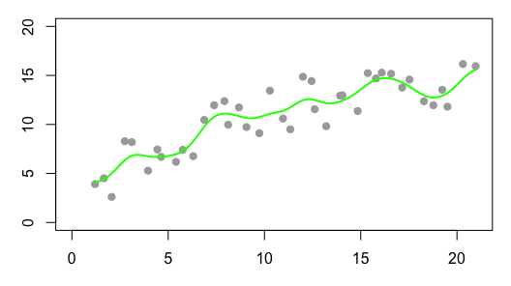
Smoothing Scatter plots
Rather than a simple average
We use kernels positioned on the x_{i} to determine the weights to place on the y_{i} in the average
The denominator ensures the weights sum to 1

Slide 92
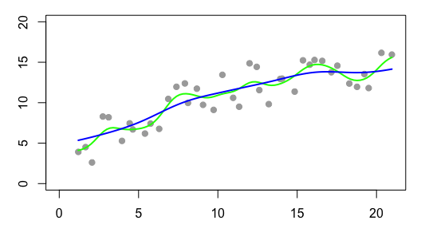
Smoothing Scatter plots
For each x, we find g(x) by a weighted average of the y_{i}
The y_{i} are weighted according to the kernel function.
So x_{i} far from x do not contribute much to g(x)

Slide 93
Local Smoothing
Moving window
Smooth/Average y values in the window
Many different approaches for doing this:
kernel methods (what we just showed),
cubic splines, thin plate splines,
Locally weighted smooth scatterplot (lowess)
Allows us to see shape of the relationship between y and x
Scale | Conditioning | Perception | Transformation | Context | Smoothing | Philosophy

Slide 94
Cherry Blossom Run
Scale | Conditioning | Perception | Transformation | Context | Smoothing | Philosophy

Slide 95
Cherry Blossom Run
Local Smoothing helps us see the typical run time for each age
We have controlled for year by making separate smooth curves for runners in each yearly race
Notice anything unusual?
Scale | Conditioning | Perception | Transformation | Context | Smoothing | Philosophy

Slide 96
Cherry Blossom Run
How are the data generated?
All runners in each annual CB run from 1999 to 2012
Snapshots in time – one for each year – Runners in 1999 may be quite different than runners in 2012
If we control for year and only examine the relationship between time and age for 2012, we still have a problem. These are not longitudinal data where we follow the same people in time as they age.
Scale | Conditioning | Perception | Transformation | Context | Smoothing | Philosophy
Notes:
This is NOT a longitudinal study! LS is a continued acquisition of data on the SAME PEOPLE.
Here, we’re not following the same people. We have different people of different ages at different points in time.
The race became very popular, so

Slide 97
Large p (variables) Dimension Reduction
Scale | Conditioning | Perception | Transformation | Context | Dimension Reduction | Philosophy

Slide 98
Challenge
When we have a large number of features, there is often multi-collinearity
Design doesn’t fill the space
One (or more) variable(s) highly correlated with a combination of other variables
Some times we have more features than observations
Design is over-determined
Scale | Conditioning | Perception | Transformation | Context | Dimension Reduction | Philosophy

Slide 99
Goal
Create a few new features that are functions (combinations) of original features and that preserve as much information as possible
Eliminate dimensions
Bring out strong patterns
Analyze the new features
Cluster observations
Fit models with new features
Scale | Conditioning | Perception | Transformation | Context | Dimension Reduction | Philosophy

Slide 100

2D Simple Example
Which projection has the greatest variability?
Scale | Conditioning | Perception | Transformation | Context | Dimension Reduction | Philosophy

Slide 101
3D Simple Example
Scale | Conditioning | Perception | Transformation | Context | Dimension Reduction | Philosophy

Slide 102
Simple Example - Eating in the UK
17 variables – average consumption of a food
4 records – one for each country
Can we reduce these 17 pieces of information to fewer?
Example and viz from Victor Powell http://setosa.io/ev/principal-component-analysis/
Scale | Conditioning | Perception | Transformation | Context | Dimension Reduction | Philosophy

Slide 103
Simple Example - Eating in the UK
The first two principal components (combination of original 17 variables)
Northern Ireland is different
Structure reflects real-world geography
This dimension is a combination of +potatoes – fresh fruit – fish
Scale | Conditioning | Perception | Transformation | Context | Dimension Reduction | Philosophy

Slide 104
Applications
Portfolio management in finance
High throughput genetics data
Image analysis – pattern recognition and compression
Intrusion detection in network traffic
Scale | Conditioning | Perception | Transformation | Context | Dimension Reduction | Philosophy

Slide 105
Philosophy
Scale | Conditioning | Perception | Transformation | Context | Smoothing | Philosophy

Slide 106
Reveal the Data
Choose scale appropriately
Avoid having other graph elements interfere with data
Use visually prominent symbols
Eliminate superfluous material, aka chart junk
Avoid over-plotting
Scale | Conditioning | Perception | Transformation | Context | Smoothing | Philosophy

Slide 107
Avoid over-plotting
Jitter: Add random noise so the values aren’t plotted on top of each other
Why are there so few data points?
Shrink the plotting symbol so they don’t plot on top of each other
Scale | Conditioning | Perception | Transformation | Context | Smoothing | Philosophy

Slide 108
Facilitate Comparisons
Put Juxtaposed plots on same scale
Make it easy to distinguish elements of superposed plots, e.g. with color, line type
Avoid Stacking and Jiggling the baseline
Avoid angles, extra dimensions (e.g., areas rather than lines)
Don’t break the visual metaphor, i.e., if use rectangles, then area should correspond to value
Scale | Conditioning | Perception | Transformation | Context | Smoothing | Philosophy

Slide 109
Comparison: area vs length
Order of words/counts is random – makes it difficult to compare
Broken Visual metaphor – count is represented by height of word, not area
Scale | Conditioning | Perception | Transformation | Context | Smoothing | Philosophy

Slide 110
Make a plot information rich
Describe what you see in the Caption
Add context with Reference Markers (lines and points) including text
Add Legends and Labels
Use color and plotting symbols to add more information
Plot the same thing more than once in different ways/scales
Reduce clutter
Scale | Conditioning | Perception | Transformation | Context | Smoothing | Philosophy

Slide 111
Captions
Captions should be comprehensive
Self-contained
Captions should:
Describe what has been graphed
Draw attention to important features
Describe conclusions drawn from graph
Scale | Conditioning | Perception | Transformation | Context | Smoothing | Philosophy

Slide 112
Iterate – Example Voter Registration
Location of tick marks under bars
Color of bars – indicate party
Title confusing
Y-axis label confusing
X-axis label missing
Scale | Conditioning | Perception | Transformation | Context | Smoothing | Philosophy

Slide 113
Voter Registration Trends
Check data for understanding of how plot is made
Observation? People vote, not counties
Lurking variable? County size - small counties tend to be rural and conservative
Scale | Conditioning | Perception | Transformation | Context | Smoothing | Philosophy

Slide 114
Voter Registration Trends
What is the message?
Can we improve it?
Collect better/more data
Decline to state and other parties are missing
Voter registration totals may be more useful
Scale | Conditioning | Perception | Transformation | Context | Smoothing | Philosophy

Slide 115
Good Plot Making Practice
Put major (quantitative) conclusions in graphical form
Provide reference information
Proof read for clarity and consistency
Graphing is an iterative process
Multiplicity is OK, i.e., two plots of the same variable may provide different messages
Make plots data rich

Slide 116
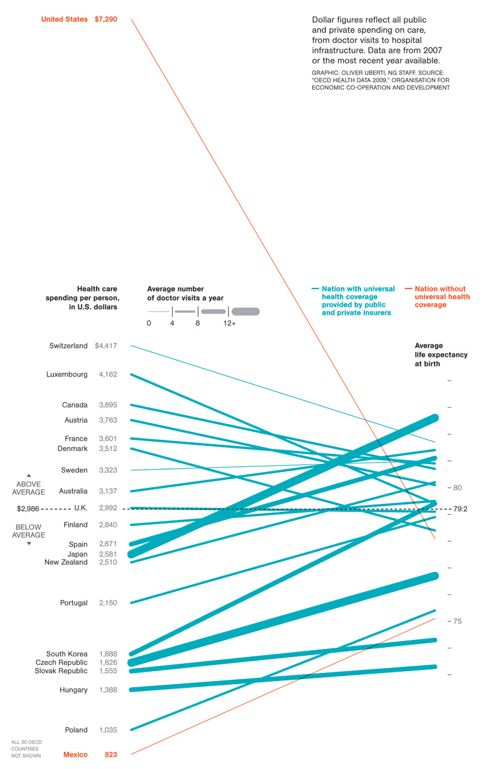
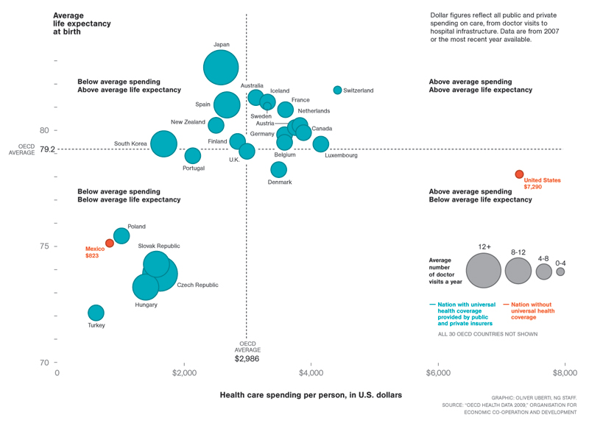
Parallel Coordinate Plot

Slide 117
Univariate Displays
Type | Plot
Numeric – | few observations Histogram, Density curve Box plot, Violin plot Normal quantile plot Few Observations - Rug plot, Dot plot Caution if discrete: density curves and box plots may be misleading
Categorical – Counts of categories | Dot chart Bar chart Pie chart (avoid!) Caution if ordinal –order of bars, dots, etc. should reflect category order

Slide 118
Bivariate Displays
 | Numeric | Categorical
Numeric | Scatter plot Smooth scatter Contour plot Smooth lines and curves | Multiple histograms, density curves, Avoid jiggling!
Categorical |  | Side-by-side bar plot Overlaid Lines plot Side-by-side dot chart Mosaic plot Avoid stacking!

